Slide 1

Application: Pet a Dog Type: Application Architecture View: Logical View Style: Layered Architecture Pattern
Users
Deliver Channels
Core Business Processes
Data And Information
Technology Enablers
User’s Personal
Messaging Bus
Web App
User Account
External Users
Booking Data
Real-time Bus
Home
Web Services
Dog Data
E-Payment
Internal Organization
Sitter Search
Transactions
Email
Tips and Tricks
Payment Information
B2C-getaway
Suppliers

Slide 2
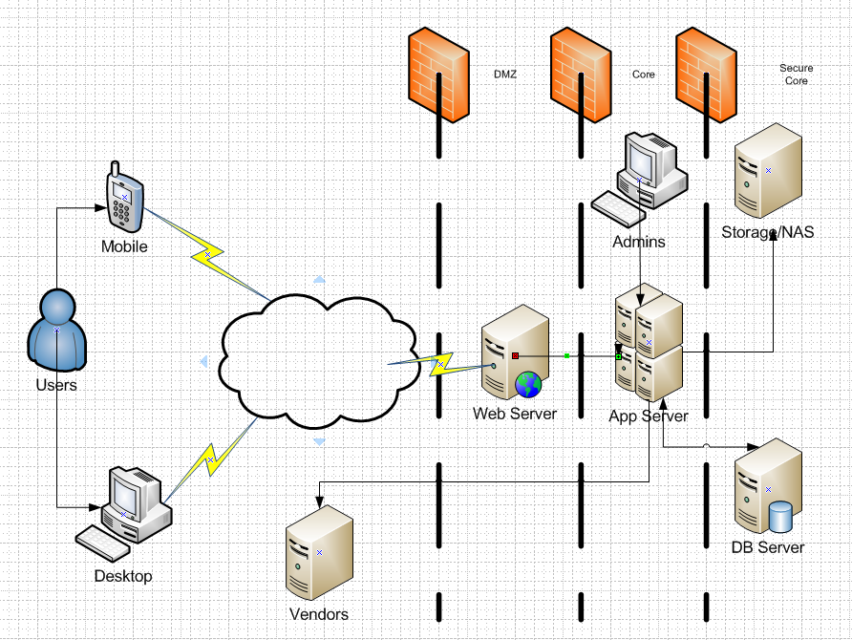
Application: Pet-A-Dog Type: Application Architecture View: Process View Style: Client-Server Pattern
Internal Organization

Slide 3
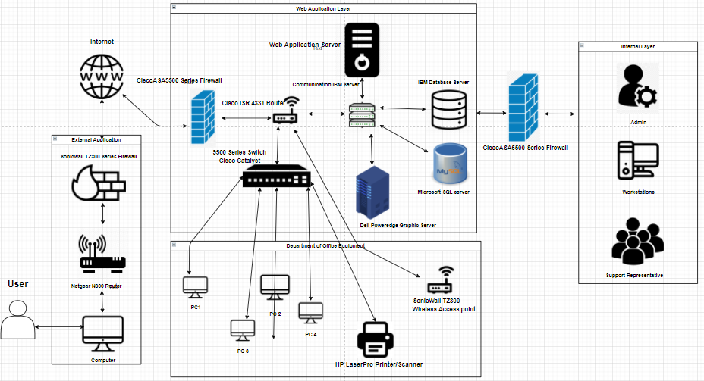
Pet a Dog
Type: Application Architecture
View: Physical View
Style: Layered Architectural Pattern

